Slide 1

Road Safety In Victoria
Presented By: Saurabh Mishra
Last Updated: 27/02/2022

Slide 2
Table of Content
Purpose Statement
How To Improve Road Safety
Data Discovery
Recommendations

Slide 3

Purpose Statement
Identify the attributes responsible for deaths and accidents rate in Victoria.

Slide 4
How To Improve Road Safety
Minimise death rate
1
Minimise accident rate
2
Prevent serious injuries
3

Slide 5
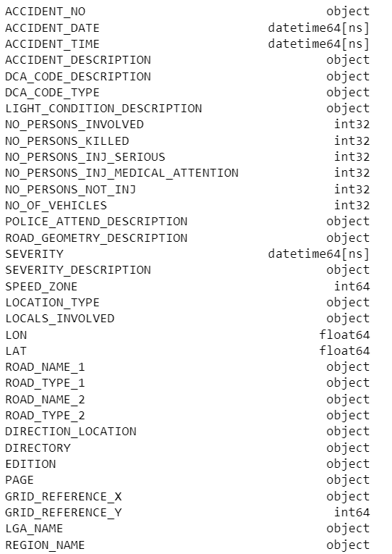
Data Discovery
Data Snippet

Slide 6
Hypothesis
Road safety is similar across all regions in Victoria.
Speed is positively correlated to death rate and accident rate.
Light condition is positively correlated to death rate and accident rate.
Collision with another vehicle is the primary reason for most accidents.

Slide 7
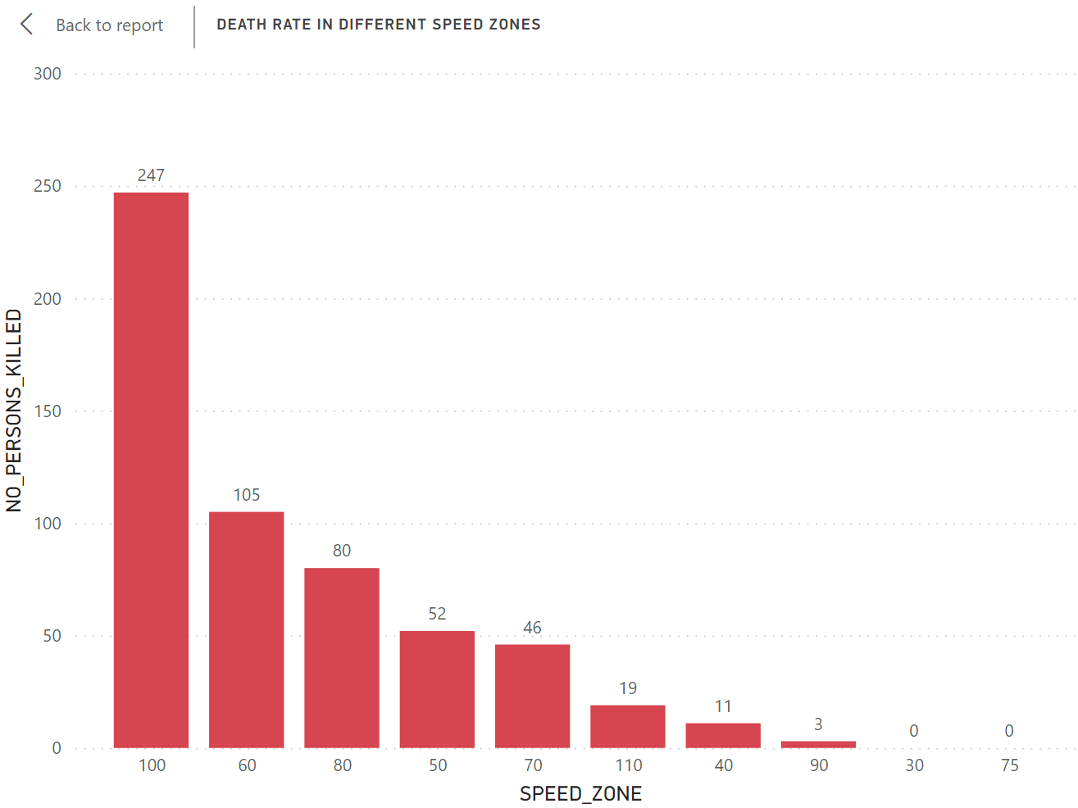
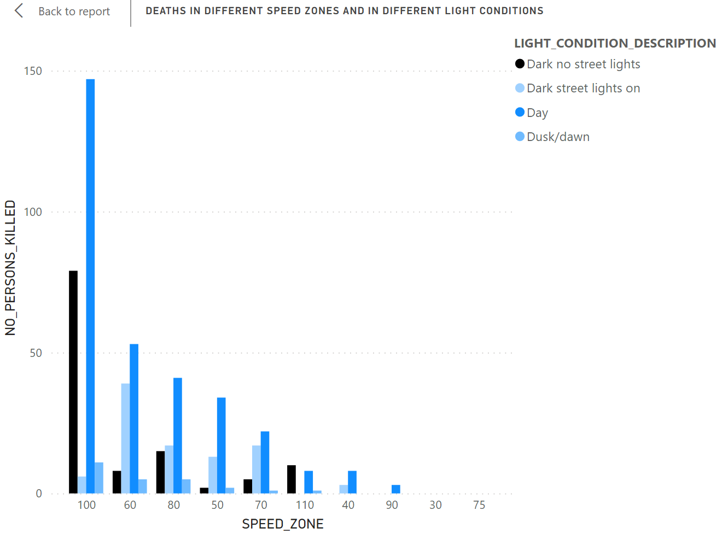
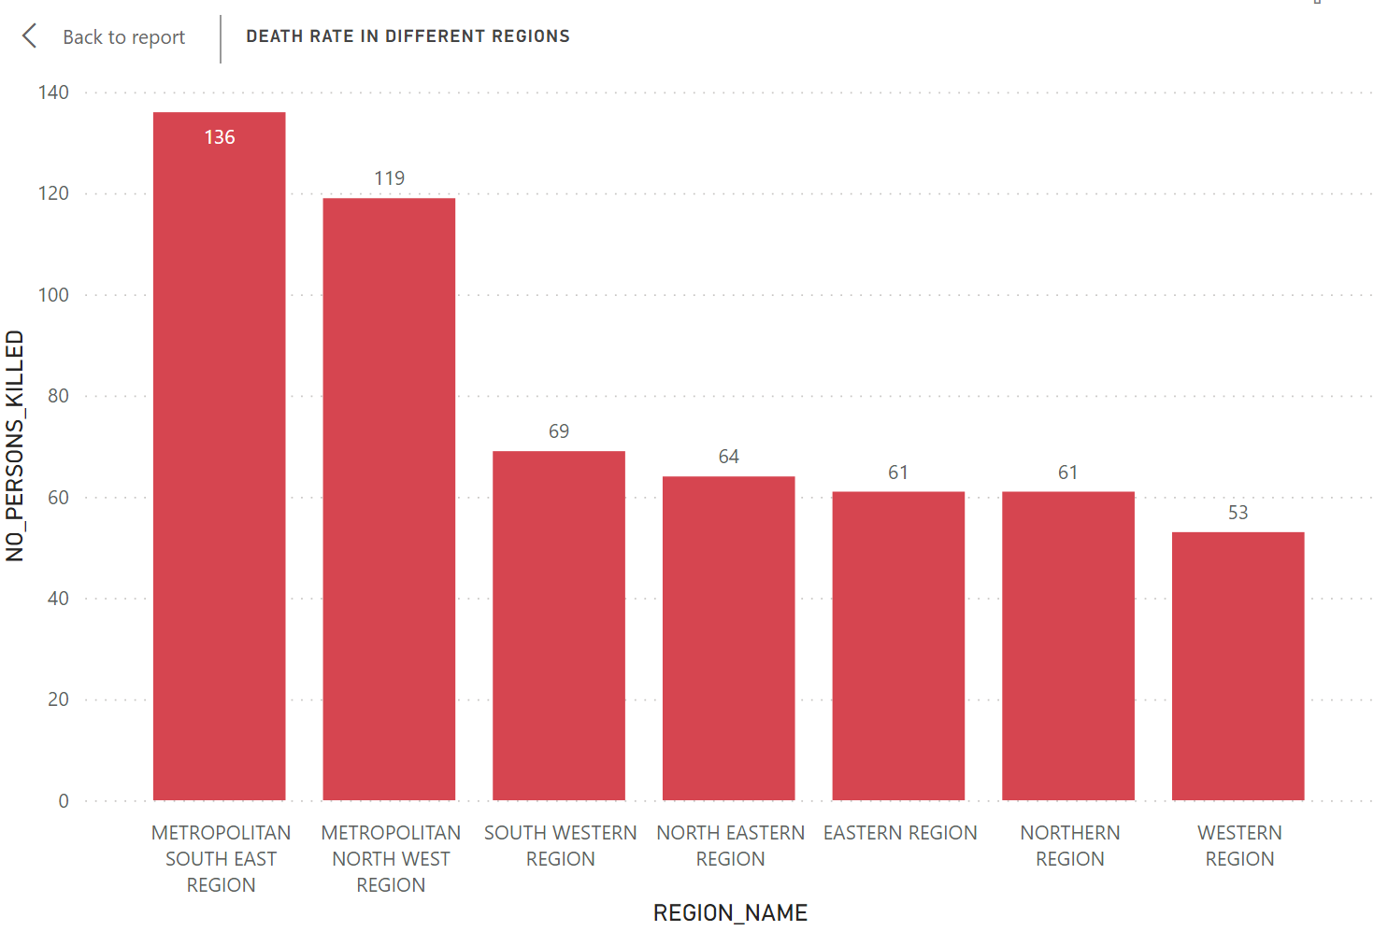
Regions, Speed Zones and Light Conditions
Southeast and Northwest regions have highest death tolls among all regions, whereas driving at 100KMH seems most dangerous.
Driving at 100KMH speed with poor light condition poses most risk.

Slide 8
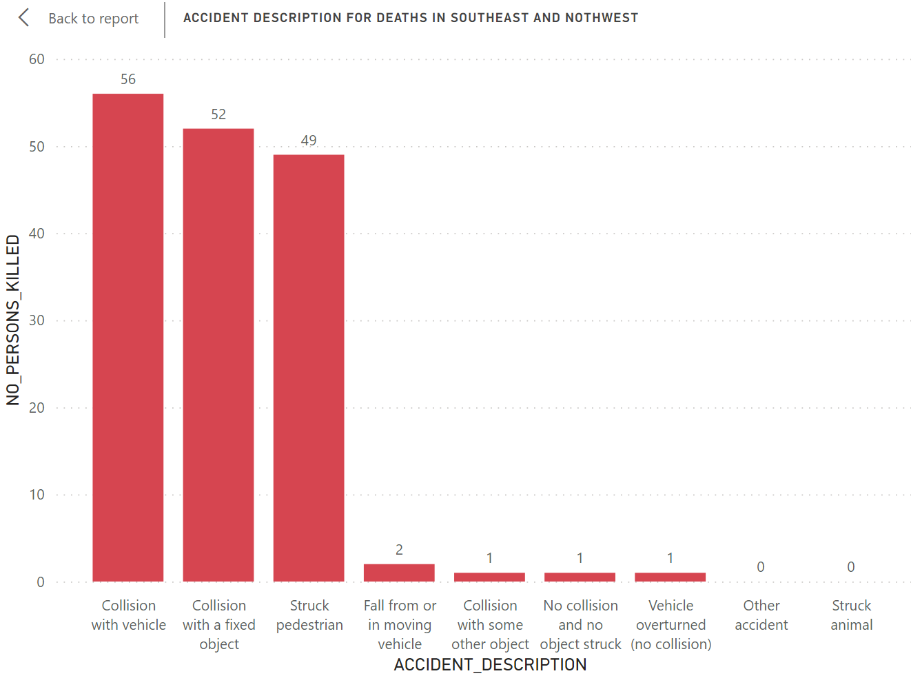
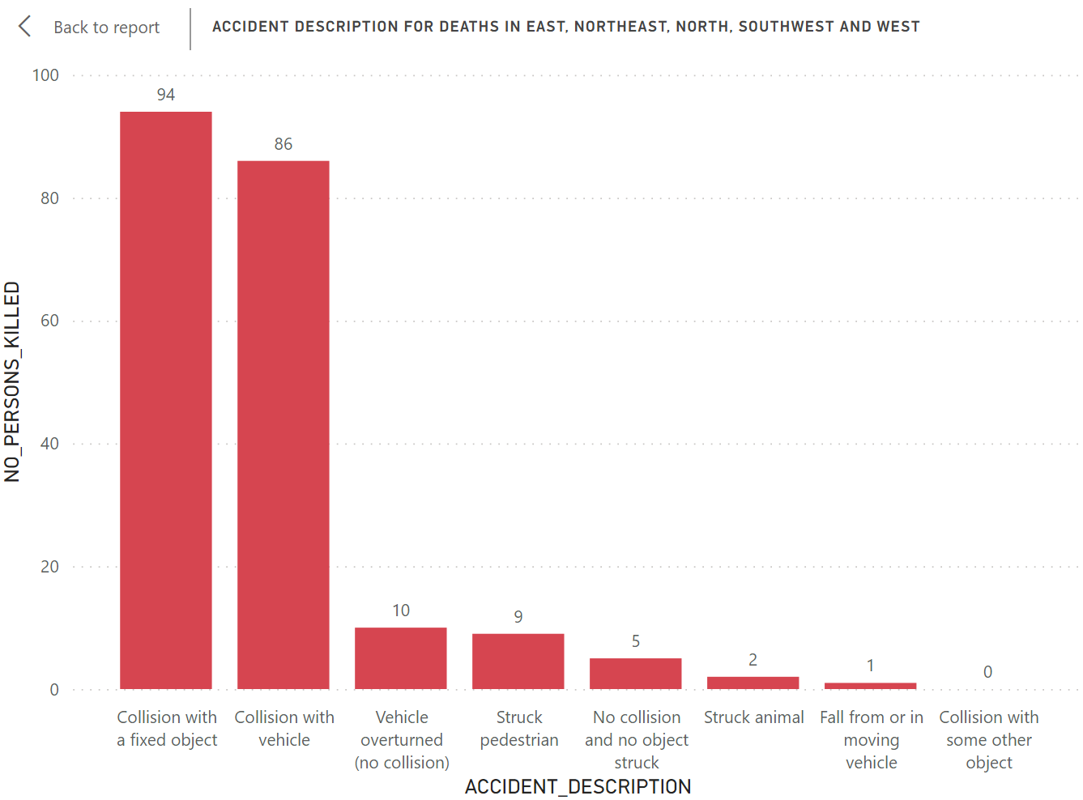
Pedestrians being struck by vehicle when speed is between 50-70KMH is one of the most common cause of accidents along with collision with another vehicle and collision with fixed object.

Slide 9
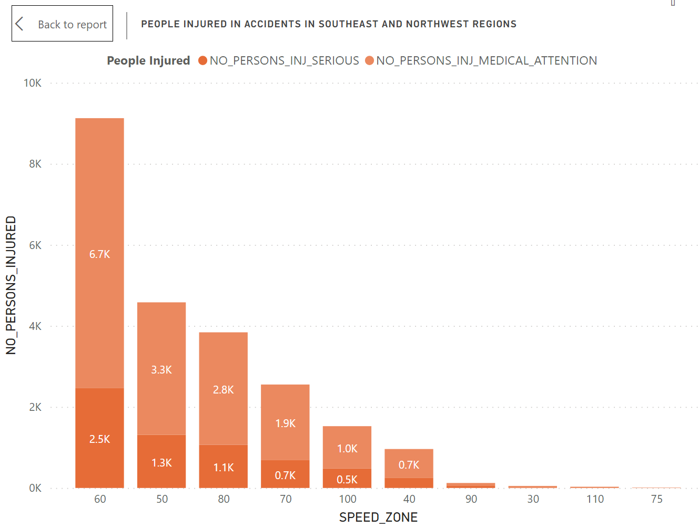
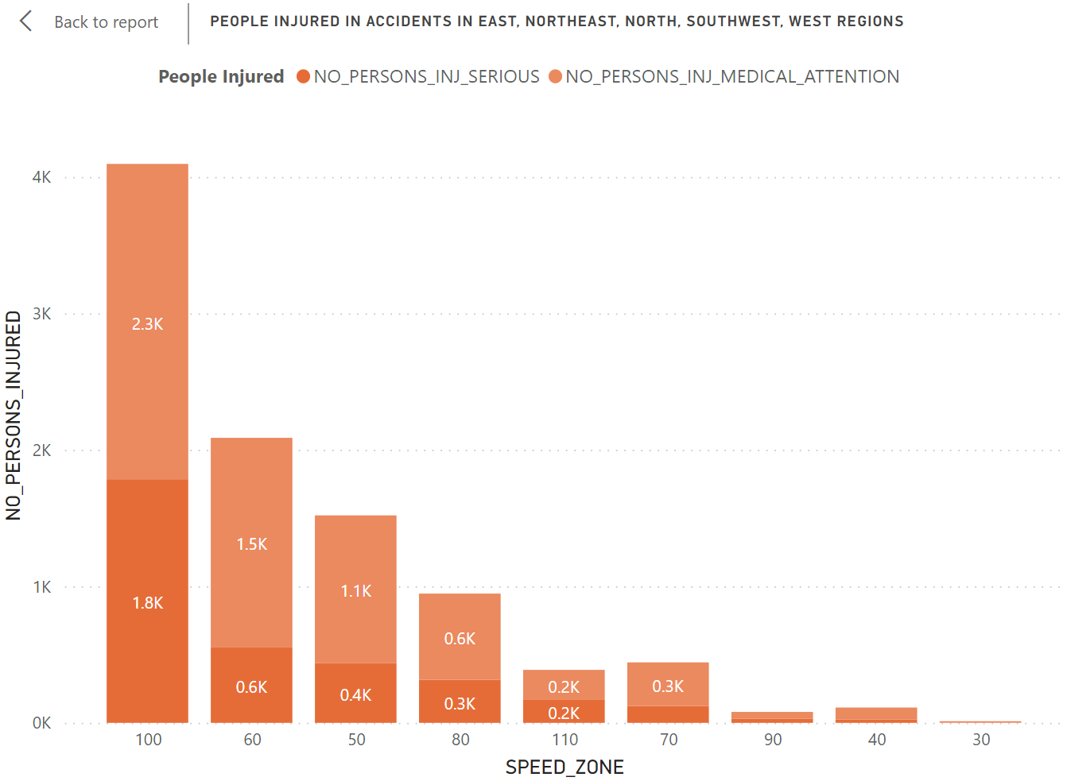
In the Southeast and Northwest regions, 60KMH speed zones pose risk for road injuries, whereas speed zones with limit of 100KMH are prone to most accidents in all the other regions

Slide 10
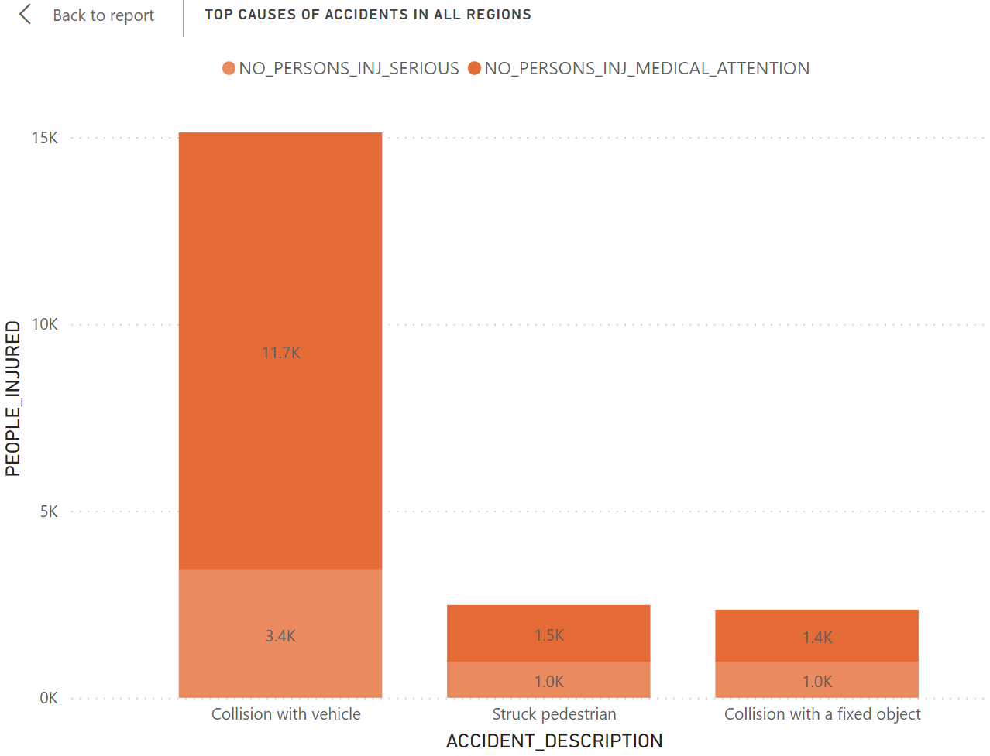
Primary cause of injury remains the same across all regions

Slide 11
Recommendations
Improve pedestrian safety in crosswalks.
Install streetlights in dark areas of 100KMH speed zone.
Promote collision avoidance technology in vehicles.

Slide 12

Thank You

